Slide 1
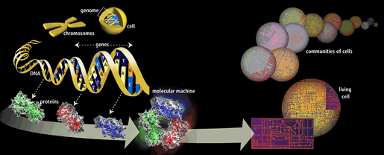
Molecular Biology Primer
Angela Brooks, Raymond Brown, Calvin Chen, Mike Daly, Hoa Dinh, Erinn Hama, Robert Hinman, Julio Ng, Michael Sneddon, Hoa Troung, Jerry Wang, Che Fung Yung

Slide 2
Outline:
0. History: Major Events in Molecular Biology
1. What Is Life Made Of?
2. What Is Genetic Material?
3. What Do Genes Do?
4. What Molecule Code For Genes?
5. What Is the Structure Of DNA?
6. What Carries Information between DNA and Proteins
7. How are Proteins Made?

Slide 3
Outline Cont.
8. How Can We Analyze DNA
1. Copying DNA
2. Cutting and Pasting DNA
3. Measuring DNA Length
4. Probing DNA
9. How Do Individuals of a Species Differ
10. How Do Different Species Differ
1. Molecular Evolution
2. Comparative Genomics
3. Genome Rearrangement

Slide 4
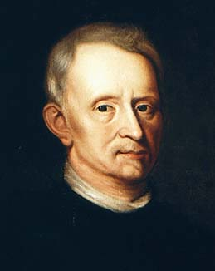
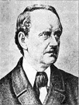
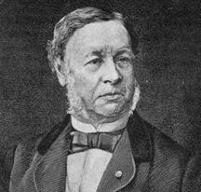
How Molecular Biology came about?
Microscopic biology began in 1665
Robert Hooke (1635-1703) discovered organisms are made up of cells
Matthias Schleiden (1804-1881) and Theodor Schwann (1810-1882) further expanded the study of cells in 1830s
Robert Hooke
Theodor Schwann
Matthias Schleiden

Slide 5
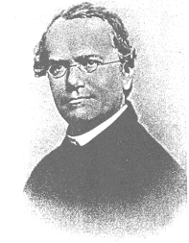
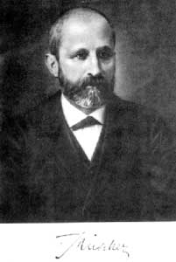
Major events in the history of Molecular Biology 1800 - 1870
1865 Gregor Mendel discover the basic rules of heredity of garden pea.
An individual organism has two alternative heredity units for a given trait (dominant trait v.s. recessive trait)
1869 Johann Friedrich Miescher discovered DNA and named it nuclein.
Mendel: The Father of Genetics
Johann Miescher
Notes:
Outline format

Slide 6
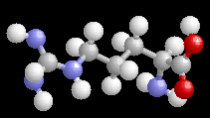
Major events in the history of Molecular Biology 1880 - 1900
1881 Edward Zacharias showed chromosomes are composed of nuclein.
1899 Richard Altmann renamed nuclein to nucleic acid.
By 1900, chemical structures of all 20 amino acids had
been identified
Notes:
Outline format

Slide 7
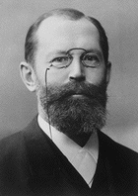
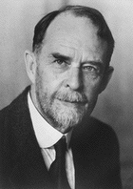
Major events in the history of Molecular Biology 1900-1911
1902 - Emil Hermann Fischer wins Nobel prize: showed amino acids are linked and form proteins
Postulated: protein properties are defined by amino acid composition and arrangement, which we nowadays know as fact
1911 – Thomas Hunt Morgan discovers genes on chromosomes are the discrete units of heredity
1911 Pheobus Aaron Theodore Lerene discovers RNA
Emil Fischer
Thomas Morgan
Notes:
Outline format

Slide 8
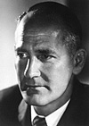
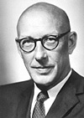
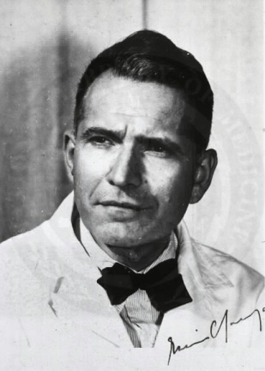
Major events in the history of Molecular Biology 1940 - 1950
1941 – George Beadle and Edward Tatum identify that genes make proteins
1950 – Edwin Chargaff find Cytosine complements Guanine and Adenine complements Thymine
George Beadle
Edward Tatum
Edwin Chargaff
Notes:
Outline format

Slide 9
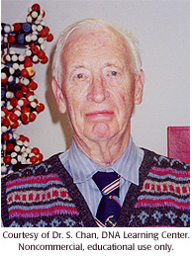
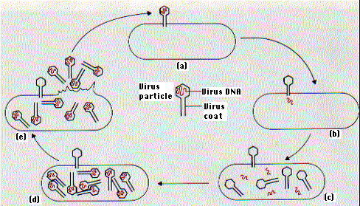
Major events in the history of Molecular Biology 1950 - 1952
1950s – Mahlon Bush Hoagland first to isolate tRNA
1952 – Alfred Hershey and Martha Chase make genes from DNA
Mahlon Hoagland
Hershey Chase Experiment
Notes:
Outline format

Slide 10
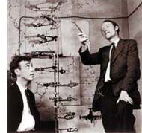

Major events in the history of Molecular Biology 1952 - 1960
1952-1953 James D. Watson and Francis H. C. Crick deduced the double helical structure of DNA
1956 George Emil Palade showed the site of enzymes manufacturing in the cytoplasm is made on RNA organelles called ribosomes.
James Watson and Francis Crick
George Emil Palade
Notes:
Outline format

Slide 11
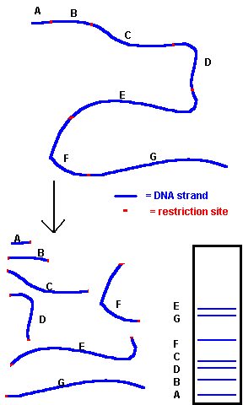
Major events in the history of Molecular Biology 1970
1970 Howard Temin and David Baltimore independently isolate the first restriction enzyme
DNA can be cut into reproducible pieces with site-specific endonuclease called restriction enzymes;
the pieces can be linked to bacterial vectors and introduced into bacterial hosts. (gene cloning or recombinant DNA technology)
Notes:
Outline format

Slide 12
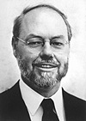
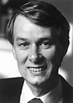
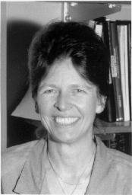
Major events in the history of Molecular Biology 1970- 1977
1977 Phillip Sharp and Richard Roberts demonstrated that pre-mRNA is processed by the excision of introns and exons are spliced together.
Joan Steitz determined that the 5’ end of snRNA is partially complementary to the consensus sequence of 5’ splice junctions.
Phillip Sharp
Richard Roberts
Joan Steitz
Notes:
Outline format

Slide 13
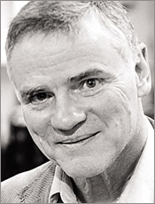
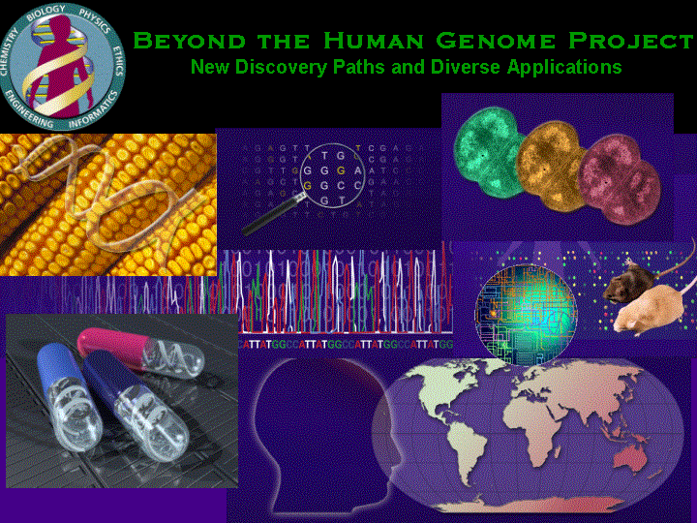
Major events in the history of Molecular Biology 1986 - 1995
1986 Leroy Hood: Developed automated sequencing mechanism
1986 Human Genome Initiative announced
1990 The 15 year Human Genome project is launched by congress
1995 Moderate-resolution maps of chromosomes 3, 11, 12, and 22 maps published (These maps provide the locations of “markers” on each chromosome to make locating genes easier)
Leroy Hood

Slide 14
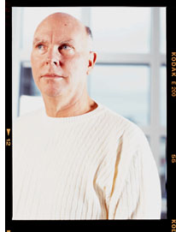
Major events in the history of Molecular Biology 1995-1996
1995 John Craig Venter: First bactierial genomes sequenced
1995 Automated fluorescent sequencing instruments and robotic operations
1996 First eukaryotic genome-yeast-sequenced
John Craig Venter

Slide 15
Major events in the history of Molecular Biology 1997 - 1999
1997 E. Coli sequenced
1998 PerkinsElmer, Inc.. Developed 96-capillary sequencer
1998 Complete sequence of the Caenorhabditis elegans genome
1999 First human chromosome (number 22) sequenced

Slide 16
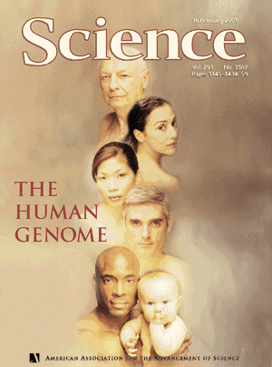
Major events in the history of Molecular Biology 2000-2001
2000 Complete sequence of the euchromatic portion of the Drosophila melanogaster genome
2001 International Human Genome Sequencing:first draft of the sequence of the human genome published

Slide 17
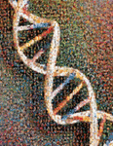
Major events in the history of Molecular Biology 2003- Present
April 2003 Human Genome Project Completed. Mouse genome is sequenced.
April 2004 Rat genome sequenced.

Slide 18
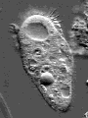
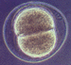
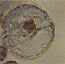
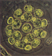
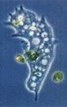
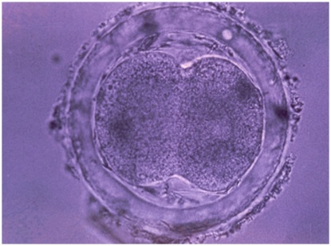
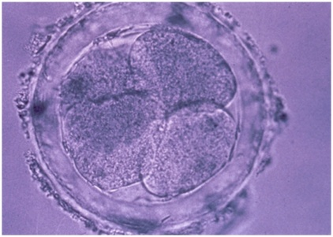
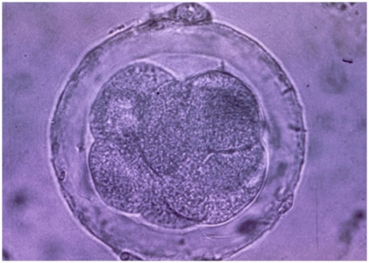
Section1: What is Life made of?

Slide 19
Cells
Fundamental working units of every living system.
Every organism is composed of one of two
radically different types of cells:
prokaryotic cells or
eukaryotic cells.
Prokaryotes and Eukaryotes are descended from the same primitive cell.
All extant prokaryotic and eukaryotic cells are the result of a total of 3.5 billion years of evolution.
Notes:
Crowded slide
Organism of life….
Cells

Slide 20
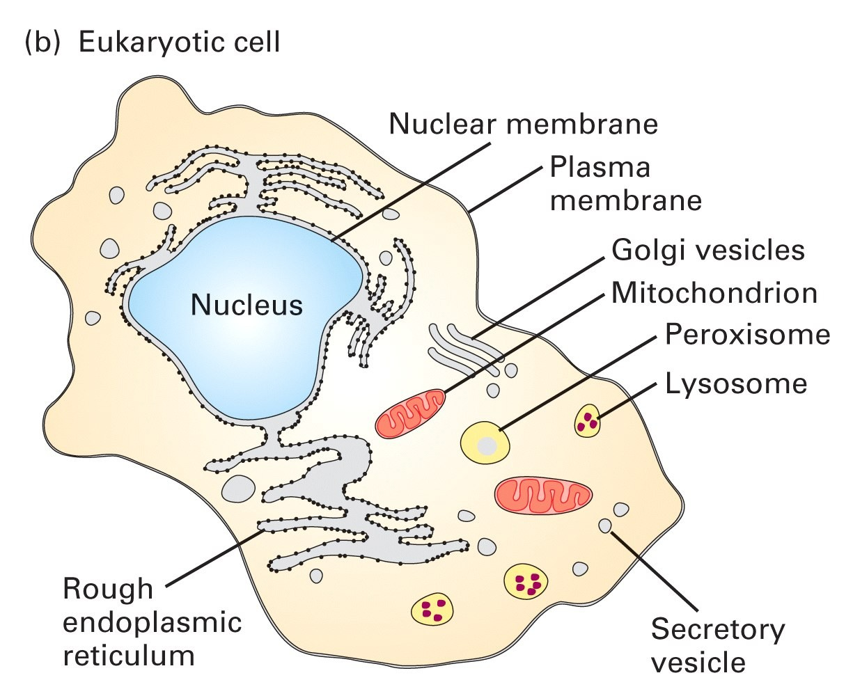
Life begins with Cell
A cell is a smallest structural unit of an organism that is capable of independent functioning
All cells have some common features

Slide 21
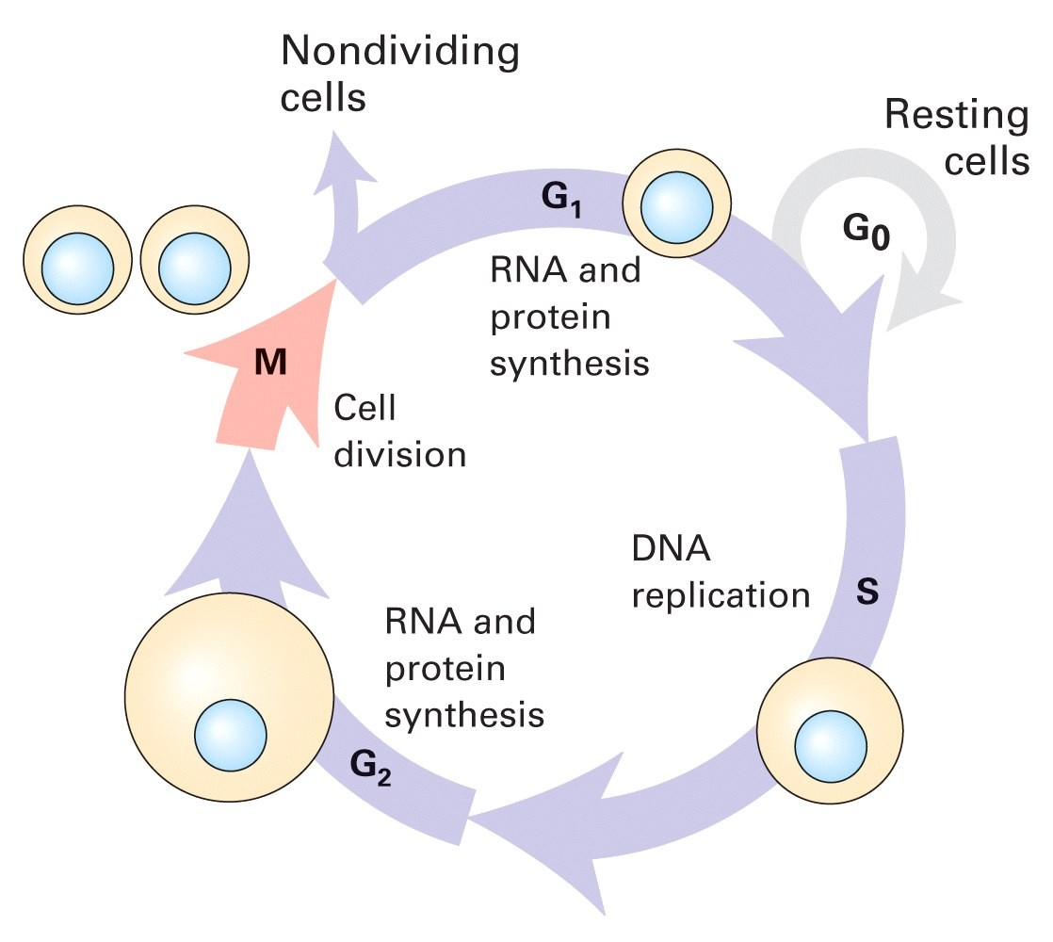
All Cells have common Cycles
Born, eat, replicate, and die

Slide 22
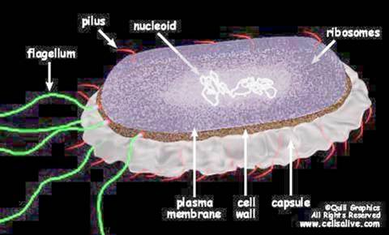
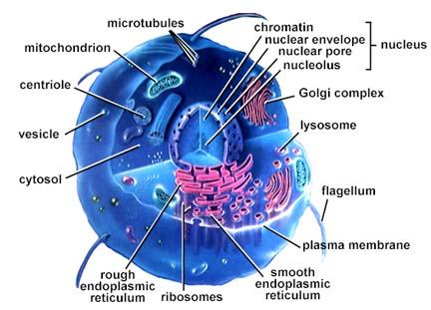
2 types of cells: Prokaryotes v.s.Eukaryotes
Notes:
Reverse sides
Delete continues

Slide 23
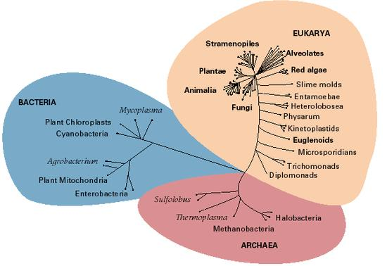
Prokaryotes and Eukaryotes
According to the most recent evidence, there are three main branches to the tree of life.
Prokaryotes include Archaea (“ancient ones”) and bacteria.
Eukaryotes are kingdom Eukarya and includes plants, animals, fungi and certain algae.

Slide 24
Prokaryotes and Eukaryotes, continued
Prokaryotes | Eukaryotes
Single cell | Single or multi cell
No nucleus | Nucleus
No organelles | Organelles
One piece of circular DNA | Chromosomes
No mRNA post transcriptional modification | Exons/Introns splicing

Slide 25
Overview of organizations of life
Nucleus = library
Chromosomes = bookshelves
Genes = books
Almost every cell in an organism contains the same libraries and the same sets of books.
Books represent all the information (DNA) that every cell in the body needs so it can grow and carry out its various functions.

Slide 26
Some Terminology
Genome: an organism’s genetic material
Gene: a discrete units of hereditary information located on the chromosomes and consisting of DNA.
Genotype: The genetic makeup of an organism
Phenotype: the physical expressed traits of an organism
Nucleic acid: Biological molecules (RNA and DNA) that allow organisms to reproduce;

Slide 27
More Terminology
The genome is an organism’s complete set of DNA, including all of its genes.
each genome contains all of the information needed to build and maintain that organism.
The genome includes both the genes and the non-coding sequences of the DNA.
a bacteria contains about 600,000 DNA base pairs
human and mouse genomes have some 3 billion.
Chromosomes
human genome has 46 (23 pairs) distinct chromosomes.
Each chromosome contains many genes.
Gene
basic physical and functional units of heredity.
specific sequences of DNA bases that encode instructions on how to make proteins.
Proteins
Make up the cellular structure
large, complex molecules made up of smaller subunits called amino acids.

Slide 28
All Life depends on 3 critical molecules
DNAs
Hold information on how cell works
RNAs
Act to transfer short pieces of information to different parts of cell
Provide templates to synthesize into protein
Proteins
Form enzymes that send signals to other cells and regulate gene activity
Form body’s major components (e.g. hair, skin, etc.)

Slide 29
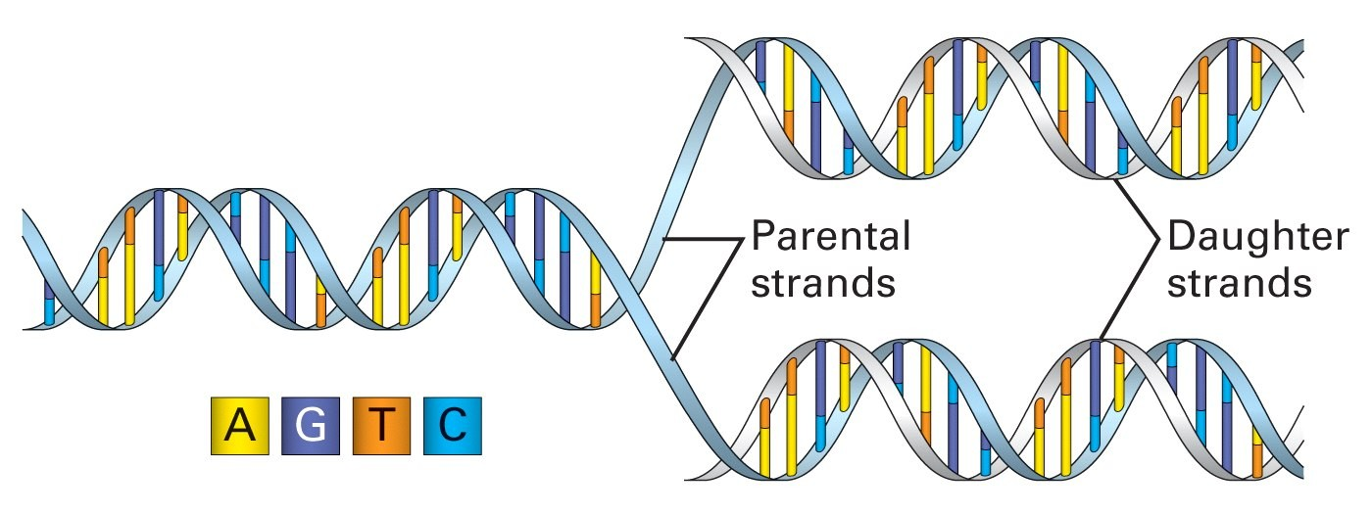
DNA: The Code of Life
The structure and the four genomic letters code for all living organisms
Adenine, Guanine, Thymine, and Cytosine which pair A-T and C-G on complimentary strands.

Slide 30
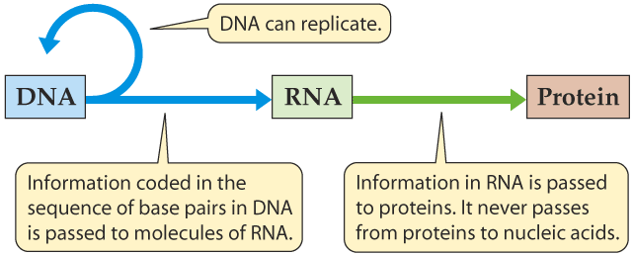
DNA, RNA, and the Flow of Information
Replication
Transcription
Translation

Slide 31
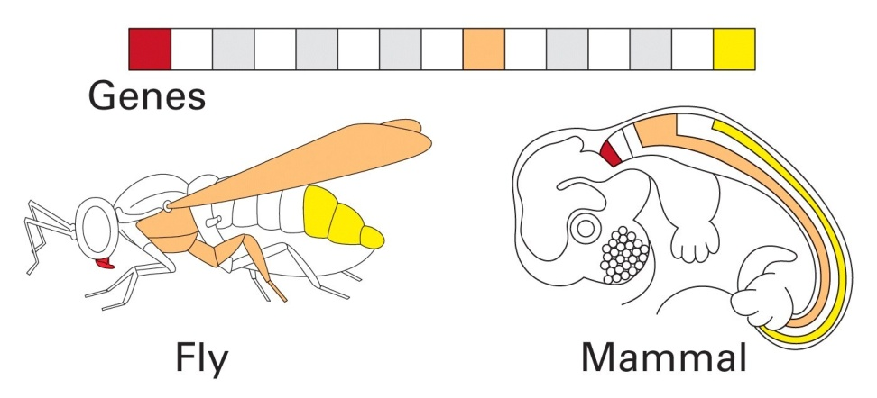
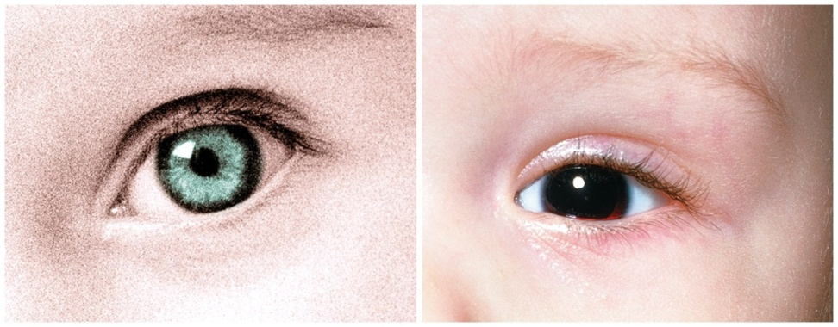
DNA the Genetics Makeup
Genes are inherited and are expressed
genotype (genetic makeup)
phenotype (physical expression)
On the left, is the eye’s phenotypes of green and black eye genes.

Slide 32
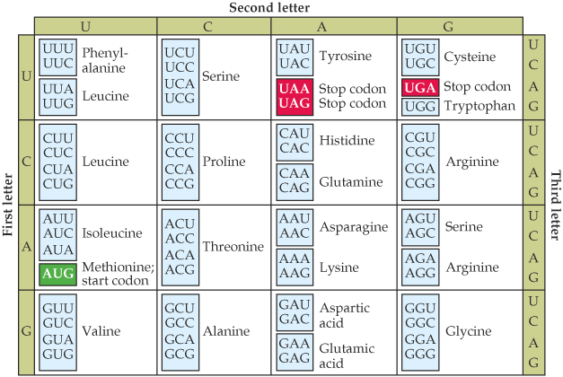
Cell Information: Instruction book of Life
DNA, RNA, and Proteins are examples of strings written in either the four-letter nucleotide of DNA and RNA (A C G T/U)
or the twenty-letter amino acid of proteins. Each amino acid is coded by 3 nucleotides called codon. (Leu, Arg, Met, etc.)

Slide 33
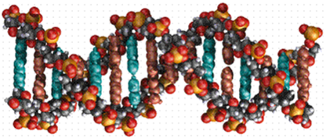
Section 2: Genetic Material of Life

Slide 34
Outline For Section 2:
What is Genetic Material?
Mendel’s experiments
Pea plant experiments
Mutations in DNA
Good, Bad, Silent
Chromosomes
Linked Genes
Gene Order
Genetic Maps
Chromosomes and sexual reproduction

Slide 35
Mendel and his Genes
What are genes?
-physical and functional traits that are passed on from one generation to the next.
Genes were discovered by Gregor Mendel in the 1860s while he was experimenting with the pea plant. He asked the question:
Do traits come from a blend of both parent's traits
or from only one parent?

Slide 36
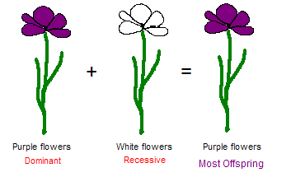
The Pea Plant Experiments
Mendel discovered that genes were passed on to offspring by both parents in two forms: dominant and recessive.
The dominant form would be the phenotypic characteristic of the offspring

Slide 37
DNA: the building blocks of genetic material
DNA was later discovered to be the molecule that makes up the inherited genetic material.
Experiments performed by Fredrick Griffith in 1928 and experiments with bacteriophages in 1952 led to this discovery.
DNA provides a code, consisting of 4 letters, for all cellular function.
Letters in DNA code:
C A G T

Slide 38
MUtAsHONS
The DNA can be thought of as a sequence of the nucleotides: C, A, G, or T.
What happens to genes when the DNA sequence is mutated?
Normal DNA sequence:
ATCTAG
Mutated DNA sequence:
ATCGAG
G

Slide 39
The Good, the Bad, and the Silent
Mutations can serve the organism in three ways:
The Good :
The Bad :
The Silent:
A mutation can cause a trait that enhances the organism’s function:
Mutation in the sickle cell gene provides resistance to malaria.
A mutation can cause a trait that is harmful, sometimes fatal to the organism:
Huntington’s disease, a symptom of a gene mutation, is a degenerative disease of the nervous system.
A mutation can simply cause no difference in the function of the organism.
Campbell, Biology, 5th edition, p. 255

Slide 40
Genes are Organized into Chromosomes
What are chromosomes?
It is a thread like structure found in the nucleus of the cell which is made from a long strand of DNA. Different organisms have a different number of chromosomes in their cells.
Thomas Morgan(1920s) - Evidence that genes are located on chromosomes was discovered by genetic experiments performed with flies.
Portrait of Morgan

Slide 41
The White-Eyed Male
Mostly male progeny
white-eyed
White-eyed male
X
Red-eyed
Mostly female progeny
Red-eyed female (normal)
These experiments suggest that the gene for eye color must be linked or co-inherited with the genes that determine the sex of the fly. This means that the genes occur on the same chromosome; more specifically it was the X chromosome.

Slide 42
Linked Genes and Gene Order
Along with eye color and sex, other genes, such as body color and wing size, had a higher probability of being co-inherited by the offspring→ genes are linked.
Morgan hypothesized that the closer the genes were located on a chromosome, the more often the genes are co-inherited.

Slide 43
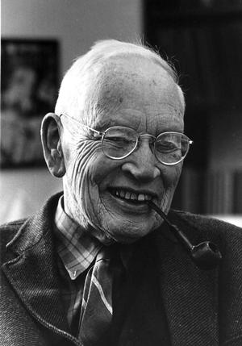
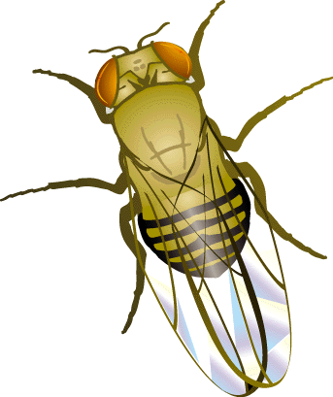
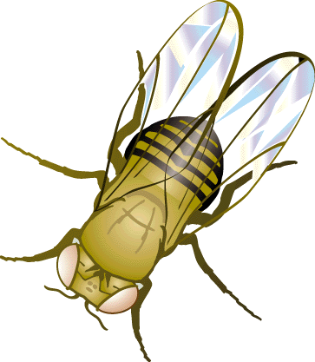
Linked Genes and Gene Order cont…
By looking at the frequency that two genes are co-inherited, genetic maps can be constructed for the location of each gene on a chromosome.
One of Morgan’s students Alfred Sturtevant pursued this idea and studied 3 fly genes:
cn
- eye color
Orange Eyes
Courtesy of the Archives, California Institue of Technology, Pasadena
White Eyes

Slide 44
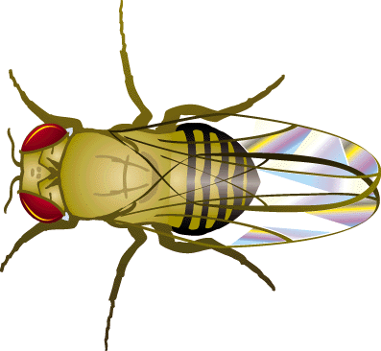
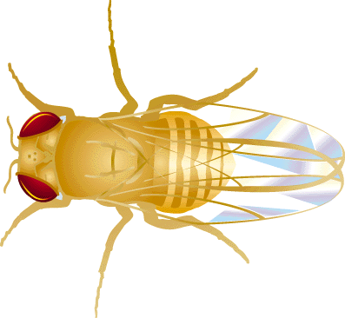
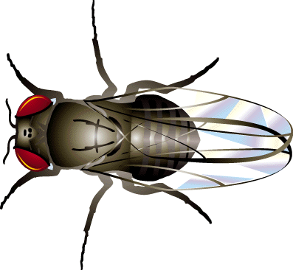
Linked Genes and Gene Order cont…
By looking at the frequency that two genes are co-inherited, genetic maps can be constructed for the location of each gene on a chromosome.
One of Morgan’s students Alfred Sturtevant pursued this idea and studied 3 fly genes:
cn
- eye color
b
- body color
Yellow Body
Normal Fly
Ebony Body

Slide 45

Linked Genes and Gene Order cont…
By looking at the frequency that two genes are co-inherited, genetic maps can be constructed for the location of each gene on a chromosome.
One of Morgan’s students Alfred Sturtevant pursued this idea and studied 3 fly genes:
cn
- eye color
b
- body color
vg
- wing size
Normal Fly
Short wings

Slide 46
What are the genes’ order on the chromosome?
Mutant b, mutant vg
X
83% progeny have both mutation
The genes vg and b are far apart from each other.
Normal fly
Mutant b, mutant cn
91% progeny have both mutation
X
Normal fly
The gene cn is close to both vg and b.
Mutant vg, mutant cn
92% progeny have both mutation
X
Normal fly

Slide 47
What are the genes’ order on the chromosome?
b
cn
vg
This is the order of the genes, on the chromosome,
determined by the experiment

Slide 48
Section 3: What Do Genes Do?

Slide 49

Genes Make Proteins
genome-> genes ->protein (forms cellular structural & life functional) -> pathways & physiology

Slide 50
Proteins: Workhorses of the Cell
20 different amino acids
different chemical properties cause the protein chains to fold up into specific three-dimensional structures that define their particular functions in the cell.
Proteins do all essential work for the cell
build cellular structures
digest nutrients
execute metabolic functions
Mediate information flow within a cell and among cellular communities.
Proteins work together with other proteins or nucleic acids as "molecular machines"
structures that fit together and function in highly specific, lock-and-key ways.

Slide 51
Section 4: What Molecule Codes For Genes?

Slide 52


Discovery of DNA
DNA Sequences
Chargaff and Vischer, 1949
DNA consisting of A, T, G, C
Adenine, Guanine, Cytosine, Thymine
Chargaff Rule
Noticing #A ≈ #T and #G ≈ #C
A “strange but possibly meaningless” phenomenon.
Wow!! A Double Helix
Watson and Crick, Nature, April 25, 1953
Rich, 1973
Structural biologist at MIT.
DNA’s structure in atomic resolution.
1 Biologist
1 Physics Ph.D. Student
900 words
Nobel Prize
Crick Watson

Slide 53


Watson & Crick – “…the secret of life”
Watson: a zoologist, Crick: a physicist
“In 1947 Crick knew no biology and practically no organic chemistry or crystallography..” – www.nobel.se
Applying Chargaff’s rules and the X-ray image from Rosalind Franklin, they constructed a “tinkertoy” model showing the double helix
Their 1953 Nature paper: “It has not escaped our notice that the specific pairing we have postulated immediately suggests a possible copying mechanism for the genetic material.”
Watson & Crick with DNA model
Rosalind Franklin with X-ray image of DNA

Slide 54

Section 5: The Structure of DNA

Slide 55

DNA
Stores all information of life
4 “letters” base pairs. AGTC (adenine, guanine, thymine, cytosine ) which pair A-T and C-G on complimentary strands.

Slide 56
DNA: The Code of Life
The structure and the four genomic letters code for all living organisms
Adenine, Guanine, Thymine, and Cytosine which pair A-T and C-G on complimentary strands.

Slide 57

DNA, continued
DNA has a double helix structure which composed of
sugar molecule
phosphate group
and a base (A,C,G,T)
DNA always reads from 5’ end to 3’ end for transcription replication
5’ ATTTAGGCC 3’

Slide 58
DNA, continued
DNA has a double helix structure. However, it is not symmetric. It has a “forward” and “backward” direction. The ends are labeled 5’ and 3’ after the Carbon atoms in the sugar component.
5’ AATCGCAAT 3’
DNA always reads 5’ to 3’ for transcription replication

Slide 59

DNA, continued
What is meant by 5' and 3' ?
Each nucleotide comprises:
1. one ribose (a 5 carbon sugar ring, each carbon is numbered 1 to 5);
2. one phosphate group; and
3. one nitrogenous base (A, T, C or G).
The phosphate group is attached to C5 (the 5th carbon) of ribose.
The nitrogenous base is attached to C1 of the ribose.
There's a hydroxyl group (-OH) attached to C3 of the ribose.
This is important to DNA formation.

Slide 60

DNA, continued
What is meant by 5' and 3' ?
DNA strands are formed when the phosphate of one nucleotide attacks and replaces the -OH on C3 of another nucleotide.

Slide 61


DNA: The Basis of Life
Deoxyribonucleic Acid (DNA)
Double stranded with complementary strands A-T, C-G
DNA is a polymer
Sugar-Phosphate-Base
Bases held together by H bonding to the opposite strand

Slide 62
Basic Structure
Phosphate
Sugar

Slide 63
Basic Structure Implications
DNA is (-) charged due to phosphate:
gel electrophoresis, DNA sequencing (Sanger method)
H-bonds form between specific bases: hybridization – replication, transcription, translation
DNA microarrays, hybridization blots, PCR
C-G bound tighter than A-T due to triple H-bond
DNA-protein interactions (via major & minor grooves): transcriptional regulation
DNA polymerization:
5’ to 3’ – phosphodiester bond formed between 5’ phosphate and 3’ OH

Slide 64
Double helix of DNA
The double helix of DNA has these features:
Concentration of adenine (A) is equal to thymine (T)
Concentration of cytosine (C) is equal to guanine (G).
Watson-Crick base-pairing A will only base-pair with T, and C with G
base-pairs of G and C contain three H-bonds,
Base-pairs of A and T contain two H-bonds.
G-C base-pairs are more stable than A-T base-pairs
Two polynucleotide strands wound around each other.
The backbone of each consists of alternating deoxyribose and phosphate groups

Slide 65


Double helix of DNA

Slide 66
Section 6: What carries information between DNA to Proteins

Slide 67

Central Dogma
(DNA→RNA→protein) The paradigm that DNA directs its transcription to RNA, which is then translated into a protein.
Transcription
(DNA→RNA) The process which transfers genetic information from the DNA to the RNA.
Translation
(RNA→protein) The process of transforming RNA to protein as specified by the genetic code.

Slide 68

Central Dogma of Molecular Biology
The information for making proteins is stored in DNA. There is a process (transcription and translation) by which DNA is converted to protein. By understanding this process and how it is regulated we can make predictions and models of cells.
Assembly
Protein Sequence Analysis
Sequence analysis
Gene Finding

Slide 69

RNA
RNA is similar to DNA chemically. It is usually only a single strand. T(hyamine) is replaced by U(racil)
Some forms of RNA can form secondary structures by “pairing up” with itself. This can have change its properties dramatically.
DNA and RNA
can pair with
each other.
tRNA linear and 3D view:

Slide 70
RNA, continued
Several types exist, classified by function
mRNA – this is what is usually being referred to when a Bioinformatician says “RNA”. This is used to carry a gene’s message out of the nucleus.
tRNA – transfers genetic information from mRNA to an amino acid sequence
rRNA – ribosomal RNA. Part of the ribosome which is involved in translation.

Slide 71

Transcription
The process of making RNA from DNA
Catalyzed by “transcriptase” enzyme
Needs a promoter region to begin transcription.
~50 base pairs/second in bacteria, but multiple transcriptions can occur simultaneously

Slide 72

DNA → RNA: Transcription
DNA gets transcribed by a protein known as RNA-polymerase
This process builds a chain of bases that will become mRNA
RNA and DNA are similar, except that RNA is single stranded and thus less stable than DNA
Also, in RNA, the base Uracil (U) is used instead of Thymine (T), the DNA counterpart

Slide 73
Transcription, continued
Transcription is highly regulated. Most DNA is in a dense form where it cannot be transcribed.
To begin transcription requires a promoter, a small specific sequence of DNA to which polymerase can bind (~40 base pairs “upstream” of gene)
Finding these promoter regions is a partially solved problem that is related to motif finding.
There can also be repressors and inhibitors acting in various ways to stop transcription. This makes regulation of gene transcription complex to understand.

Slide 74
Central Dogma Revisited
Transcription
Splicing
DNA
hnRNA
mRNA
Nucleus
Spliceosome
Translation
protein
Ribosome in Cytoplasm
Base Pairing Rule: A and T or U is held together by 2 hydrogen bonds and G and C is held together by 3 hydrogen bonds.

Slide 75
Central Dogma Revisited
Transcription
Splicing
DNA
hnRNA
mRNA
Nucleus
Spliceosome
Translation
protein
Ribosome in Cytoplasm
Pre-mRNA, also termed heterogeneous nuclear RNA (hnRNA), is an immature single strand of mRNA.
Pre-mRNA is synthesized from a DNA template in the cell nucleus by transcription.
Once pre-mRNA has been completely processed, it is termed "mature mRNA", or simply "mRNA".

Slide 76

Splicing

Slide 77
Splicing and other RNA processing
In Eukaryotic cells, RNA is processed between transcription and translation.
This complicates the relationship between a DNA gene and the protein it codes for.
Sometimes alternate RNA processing can lead to an alternate protein as a result. This is true in the immune system.

Slide 78

Splicing (Eukaryotes)
Unprocessed RNA is composed of Introns and Extrons. Introns are removed before the rest is expressed and converted to protein.
Sometimes alternate splicings can create different valid proteins.
A typical Eukaryotic gene has 4-20 introns. Locating them by analytical means is not easy.

Slide 79
Section 7: How Are Proteins Made? (Translation)

Slide 80
Terminology for Ribosome
Codon: The sequence of 3 nucleotides in DNA/RNA that encodes for a specific amino acid.
mRNA (messenger RNA): A ribonucleic acid whose sequence is complementary to that of a protein-coding gene in DNA.
Ribosome: The organelle that synthesizes polypeptides under the direction of mRNA
rRNA (ribosomal RNA):The RNA molecules that constitute the bulk of the ribosome and provides structural scaffolding for the ribosome and catalyzes peptide bond formation.
tRNA (transfer RNA): The small L-shaped RNAs that deliver specific amino acids to ribosomes according to the sequence of a bound mRNA.

Slide 81
Uncovering the code
Scientists conjectured that proteins came from DNA; but how did DNA code for proteins?
If one nucleotide codes for one amino acid, then there’d be 4¹ amino acids
However, there are 20 amino acids, so at least 3 bases codes for one amino acid, since 4² = 16 and 4³ = 64
This triplet of bases is called a “codon”
64 different codons and only 20 amino acids means that the coding is degenerate: more than one codon sequence code for the same amino acid

Slide 82

Revisiting the Central Dogma
In going from DNA to proteins, there is an intermediate step where mRNA is made from DNA, which then makes protein
This known as The Central Dogma
Why the intermediate step?
DNA is kept in the nucleus, while protein sythesis happens in the cytoplasm, with the help of ribosomes

Slide 83

The Central Dogma (cont’d)

Slide 84
RNA → Protein: Translation
Ribosomes and transfer-RNAs (tRNA) run along the length of the newly synthesized mRNA, decoding one codon at a time to build a growing chain of amino acids (“peptide”)
The tRNAs have anti-codons, which complimentarily match the codons of mRNA to know what protein gets added next
But first, in eukaryotes, a phenomenon called splicing occurs
Introns are non-protein coding regions of the mRNA; exons are the coding regions
Introns are removed from the mRNA during splicing so that a functional, valid protein can form

Slide 85

Translation
The process of going from RNA to polypeptide.
Three base pairs of RNA (called a codon) correspond to one amino acid based on a fixed table.
Always starts with Methionine and ends with a stop codon

Slide 86

Translation, continued
Catalyzed by Ribosome
Using two different sites, the Ribosome continually binds tRNA, joins the amino acids together and moves to the next location along the mRNA
~10 codons/second, but multiple translations can occur simultaneously
http://wong.scripps.edu/PIX/ribosome.jpg

Slide 87

Protein Synthesis: Summary
There are twenty amino acids, each coded by three- base-sequences in DNA, called “codons”
This code is degenerate
The central dogma describes how proteins derive from DNA
DNA → mRNA → (splicing?) → protein
The protein adopts a 3D structure specific to it’s amino acid arrangement and function

Slide 88
Proteins
Complex organic molecules made up of amino acid subunits
20* different kinds of amino acids. Each has a 1 and 3 letter abbreviation.
http://www.indstate.edu/thcme/mwking/amino-acids.html for complete list of chemical structures and abbreviations.
Proteins are often enzymes that catalyze reactions.
Also called “poly-peptides”
*Some other amino acids exist but not in humans.

Slide 89
Protein Folding
Proteins are not linear structures, though they are built that way
The amino acids have very different chemical properties; they interact with each other after the protein is built
This causes the protein to start fold and adopting it’s functional structure
Proteins may fold in reaction to some ions, and several separate chains of peptides may join together through their hydrophobic and hydrophilic amino acids to form a polymer

Slide 90

Protein Folding (cont’d)
The structure that a protein adopts is vital to it’s chemistry
Its structure determines which of its amino acids are exposed carry out the protein’s function
Its structure also determines what substrates it can react with

Slide 91
Section 8: How Can We Analyze DNA?

Slide 92
Analyzing a Genome
How to analyze a genome in four easy steps.
Cut it
Use enzymes to cut the DNA into small fragments.
Copy it
Copy it many times to make it easier to see and detect.
Read it
Use special chemical techniques to read the small fragments.
Assemble it
Take all the fragments and put them back together. This is hard!!!
Bioinformatics takes over
What can we learn from the sequenced DNA.
Compare interspecies and intraspecies.

Slide 93
8.1 Copying DNA
An Introduction to Bioinformatics Algorithms

Slide 94
Why we need so many copies
Biologists needed to find a way to read DNA codes.
How do you read base pairs that are angstroms in size?
It is not possible to directly look at it due to DNA’s small size.
Need to use chemical techniques to detect what you are looking for.
To read something so small, you need a lot of it, so that you can actually detect the chemistry.
Need a way to make many copies of the base pairs, and a method for reading the pairs.

Slide 95

Polymerase Chain Reaction (polymerase: an enzyme that catalyzes the formation of new DNA and RNA from an existing strand of DNA or RNA)
Problem: Modern instrumentation cannot easily detect single molecules of DNA, making amplification is a prerequisite for further analysis
Solution: PCR doubles the number of DNA fragments at every iteration
1… 2… 4… 8…

Slide 96
Polymerase Chain Reaction
A basic Polymerase Chain Reaction set up requires several components and reagents. These include
DNA Template: it contains the DNA region (target) to be amplified.
Two Primers: Some short (20- to 30-letter) synthesized DNA fragments. These must be complementary to the ends of each of the sense and anti-sense strand of the target DNA.
Taq Polymerase: This polymerase has an ability to add a complementary copy to a single-stranded DNA as long as there is a primer.

Slide 97

Polymerase Chain Reaction (PCR)
Polymerase Chain Reaction (PCR)
Used to massively replicate DNA sequences.
How it works:
Separate the two strands with low heat
Add some base pairs, primer sequences, and DNA Polymerase
Creates double stranded DNA from a single strand.
Primer sequences create a seed from which double stranded DNA grows.
Now you have two copies.
Repeat. Amount of DNA grows exponentially.
1→2→4→8→16→32→64→128→256…

Slide 98

Denaturation
Raise temperature to 94ºC to separate the duplex form of DNA into single strands

Slide 99
Design primers
To perform PCR, a 20-30bp sequence on either side of the sequence to be amplified must be known because DNA polymerase requires a primer to synthesize a new strand of DNA

Slide 100

Annealing
Anneal primers at 50-65ºC

Slide 101

Annealing
Anneal primers at 50-65ºC

Slide 102
Extension
Extend primers: raise temp to 72ºC, allowing Taq polymerase to attach at each priming site and extend a new DNA strand

Slide 103

Extension
Extend primers: raise temp to 72ºC, allowing Taq polymerase to attach at each priming site and extend a new DNA strand

Slide 104

Repeat
Repeat the Denature, Anneal, Extension steps at their respective temperatures…

Slide 105


Polymerase Chain Reaction

Slide 106


Cloning DNA
DNA Cloning
Insert the fragment into the genome of a living organism and watch it multiply.
Once you have enough, remove the organism, keep the DNA.
Use Polymerase Chain Reaction (PCR)
Vector DNA

Slide 107
8.2 Cutting and Pasting DNA
An Introduction to Bioinformatics Algorithms

Slide 108
Restriction Enzymes
A protein that destroys the internal bonds in DNA molecules, effectively cuts it into pieces.
Discovered in the early 1970’s
Used as a defense mechanism by bacteria to break down the DNA of attacking viruses.
They cut the DNA into small fragments.
Can also be used to cut the DNA of organisms.
This allows the DNA sequence to be in a more manageable bite-size pieces.
It is then possible using standard purification techniques to single out certain fragments and duplicate them to macroscopic quantities.

Slide 109

Cutting DNA
Restriction Enzyme “A” Cutting Sites
Restriction Enzyme “B” Cutting Sites
Restriction Enzymes cut DNA
Only cut at special sequences (recognition site)
DNA contains thousands of these sites.
Applying different Restriction Enzymes creates fragments of varying size.
Restriction Enzymes first bind to the recognition site in the double-stranded DNA and then cut the DNA
The cut may produce blunt or sticky ends
The BamHI cuts DNA at every occurrence of GGATCC
“A” and “B” fragments overlap
Restriction Enzyme “A” & Restriction Enzyme “B” Cutting Sites

Slide 110

Pasting DNA
Two pieces of DNA can be fused together by adding chemical bonds
Hybridization – complementary base-pairing
Ligation – fixing bonds with single strands

Slide 111
8.3 Measuring DNA Length
An Introduction to Bioinformatics Algorithms

Slide 112

Electrophoresis
A copolymer of mannose and galactose, agaraose, when melted and recooled, forms a gel with pores sizes dependent upon the concentration of agarose
The gel acts as a molecular “brake”
The phosphate backbone of DNA is highly negatively charged, therefore DNA will migrate in an electric field towards the positive pole
The size of DNA fragments can then be determined by comparing their migration in the gel to known size standards.

Slide 113

Reading DNA
Electrophoresis
Reading is done mostly by using this technique. This is based on separation of molecules by their size (and in 2D gel by size and charge).
DNA or RNA molecules are charged in aqueous solution and move to a definite direction by the action of an electric field.
The DNA molecules are either labeled with radioisotopes or tagged with fluorescent dyes. In the latter, a laser beam can trace the dyes and send information to a computer.
Given a DNA molecule it is then possible to obtain all fragments from it that end in either A, or T, or G, or C and these can be sorted in a gel experiment.
Another route to sequencing is direct sequencing using gene chips.

Slide 114

Assembling Genomes
Must take the fragments and put them back together
Not as easy as it sounds.
SCS Problem (Shortest Common Superstring)
Some of the fragments will overlap
Fit overlapping sequences together to get the shortest possible sequence that includes all fragment sequences

Slide 115
Assembling Genomes
DNA fragments contain sequencing errors
Two complements of DNA
Need to take into account both directions of DNA
Repeat problem
50% of human DNA is just repeats
If you have repeating DNA, how do you know where it goes?

Slide 116
Section 9: How Do Individuals of a Species Differ?

Slide 117
The Diversity of Life
Not only do different species have different genomes, but also different individuals of the same species have different genomes.
No two individuals of a species are quite the same – this is clear in humans but is also true in every other sexually reproducing species.
Imagine the difficulty of biologists – sequencing and studying only one genome is not enough because every individual is genetically different !!!
When we speak of “the” genome of a species, we are referring to some sort of “master” genome that is fairly representative of all the possible genomes

Slide 118





Physical Traits and Variances
Individual variations range from hair and eye color to less subtle traits such as susceptibility to malaria.
Physical variation is the reason we can pick out our friends in a crowd, however most physical traits and variation can only be seen at a cellular and molecular level.

Slide 119
Sources of Physical Variation
Physical Variation and the manifestation of traits are caused by variations in the genes and differences in environmental influences.
An example is height, which is dependent on genes as well as the nutrition of the individual.
Not all variation is inheritable – only genetic variation can be passed to offspring.
Biologists usually focus on genetic variation instead of physical variation because it is a better representation of the species.

Slide 120
Genetic Variation
Despite the wide range of physical variation, genetic variation between individuals is quite small.
Out of 3 billion nucleotides, only roughly 3 million base pairs (0.1%) are different between individual genomes of humans.
Although there is a finite number of possible variations, the number is so high (4^{3,000,000}) that we can assume no two individual people have the same genome.
What is the cause of this genetic variation?

Slide 121
Sources of Genetic Variation
Mutations are rare errors in the DNA replication process that occur at random.
When mutations occur, they affect the genetic sequence and create genetic variation between individuals.
Most mutations do not create beneficial changes and actually kill the individual.
Although mutations are the source of all new genes in a population, they are so rare that there must be another process at work to account for the large amount of diversity.

Slide 122
Sources of Genetic Variation
Recombination is the shuffling of genes that occurs through sexual mating and is the main source of genetic variation.
Recombination occurs via a process called crossing over in which genes switch positions with other genes during meiosis.
Recombination means that new generations inherit random combinations of genes from both parents.
The recombination of genes creates a seemingly endless supply of genetic variation within a species.

Slide 123
The Genome of a Species
It is important to distinguish between the genome of a species and the genome of an individual.
The genome of a species is a representation of all possible genomes that an individual might have since the basic sequence in all individuals is more or less the same.
The genome of an individual is simply a specific instance of the genome of a species.
Both types of genomes are important – we need the genome of a species to study a species as a whole, but we also need individual genomes to study genetic variation.

Slide 124
Section 10: How Do Different Species Differ?

Slide 125
How Do Different Species Differ?
As many as 99% of human genes are conserved across all mammals
The functionality of many genes is virtually the same among many organisms
It is highly unlikely that the same gene with the same function would spontaneously develop among all currently living species
The theory of evolution suggests all living things evolved from incremental change over millions of years

Slide 126

What is evolution?
A process of change in a certain direction (Merriam – Webster Online).
In Biology: The process of biological and organic change in organisms by which descendants come to differ from their ancestor (Mc GRAW –HILL Dictionary of Biological Science).
Charles Darwin first developed the Evolution idea in detail in his well-known book On the Origin of Species, published in 1859.

Slide 127
Mouse and Human overview
Mouse has 2.1 x10⁹ base pairs versus 2.9 x 10⁹ in human.
About 95% of genetic material is shared.
99% of genes shared of about 30,000 total.
The 300 genes that have no homologue in either species deal largely with immunity, detoxification, smell and sex*
*Scientific American Dec. 5, 2002

Slide 128

Human and Mouse
Significant chromosomal rearranging occurred between the diverging point of humans and mice.
Here is a mapping of human chromosome 3.
It contains homologous sequences to at least 5 mouse chromosomes.

